Slide 1
Rotary Business Partnership
Developing
Corporate Social Responsibility
and Membership
Notes:
The Rotary Business Partnership is designed to enable the business community fulfil Corporate Social Responsibility objectives by engaging in projects benefitting the local community. Rotary acts as a facilitator having local knowledge and able to provide guidance and mentoring services. It will also enable clubs to identify prospective new members from the working age groups whilst alongside volunteers.

Slide 2
A New Initiative
Attention any club interested in:
Forging ties with business community
Helping schools with an ecology project
Developing membership
Notes:
We continue to look for innovative ways to encourage clubs to raise Rotary’s profile, forge closer links with the business community to identify prospective new members from the working age group and to deliver meaningful help to the local community. We are launching a new initiative today that we are confident clubs will find attractive as it is focused on schools and the promotion of ecology projects which they are finding increasingly difficult to fund and create.

Slide 3
Background
Schools are keen to engage pupils in:
The environment
Food education
Business community are keen to:
Fulfil Corporate Social Responsibility objectives
Rotary is keen to:
Explore ways of attracting new members
Notes:
We have already done some research and schools are keen to educate pupils on the environment and food. The BP has always been about helping the business community fulfil CSR objectives. Every Rotarian should be aware that falling membership is a major concern and a threat to our existence. The BP is realistic way of showing Rotary in action and opening channels to prospective new members.

Slide 4
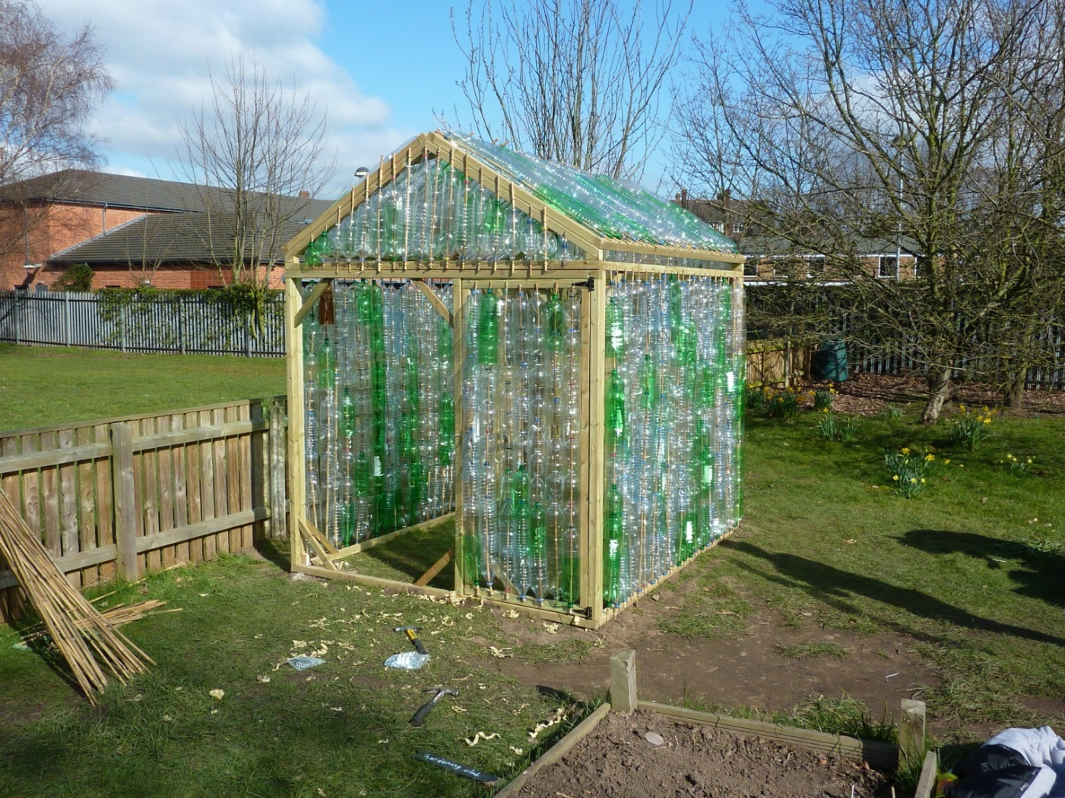
A Simple Solution
Engage with local business to build an eco-bottle greenhouse for a local school
Notes:
Our new initiative is very simple. Build eco-bottle greenhouses for schools.

Slide 5
Ticks so many boxes with schools
Environment
Pupils learn about recycling
Construction
Pupils engage with building the greenhouse
Food education
Pupils learn about growing food
Notes:
It ticks so many boxes for schools. Pupils will be expected to collect plastic bottles and learn about recycling. They can get involved with simple aspects of the construction. There is a strong drive to show where our food comes from and this includes growing their own. We have built the pilot greenhouse at a Wollaton school and the business partner, who was Waitrose, have offered to help them by holding a summer fare and allowing them to sell the food they have grown. Rotary created that relationship.

Slide 6
Easy BP Project
Ideal for any sized business:
Low cost project
4 people a maximum of 2 days to erect
Delivers their CSR objectives
Engages with local schools
Notes:
We do not believe there can be many easier projects for a club to cut their BP teeth on. The project only requires 4 volunteers from the business community for a maximum of 2 days to build the greenhouse. The cost is around £300 to purchase a greenhouse kit and we are looking to source them at a lower price. Most Rotary clubs have some links with local schools but if not it is an easy sell, particularly to the Primary Schools, and will help to establish goods links.

Slide 7
Teachers Ambitions
We know:
Keen to create eco projects for pupils
The eco-bottle greenhouse is a great start
Introduce other eco projects
Notes:
In our experience schools have an eco champion on the teaching staff and they want to grow the facilities in their schools. They see the eco-bottle greenhouse as an ideal starting point.

Slide 8
Teachers and Rotary
Our experience with teachers to date:
Interested in joining Rotary but:
Limited meeting time and no formalities
Teaching profession network
Recognise that Rotary can help schools
Notes:
We have been very encouraged by teachers positive comments about Rotary. This extends to becoming members for the good of promoting their eco and other project ambitions. They cannot afford the time for meetings and Rotary formalities. They just want to get on with doing things. There is a strong network within the teaching profession and they see that Rotary could be a significant factor in helping their children’s education.

Slide 9
Recruiting Teachers
Form a Satellite Group with a nucleus of teachers
membership of an existing club
focus on projects/actions/tasks
communicating by a chosen means such as social media
support available from existing club members
Associate membership
E-clubs
Notes:
We just need to find the right solution to recruit them. It seems viable for us to start Satellite clubs using a group of teachers from varying schools within a given area to form the nucleus of a new club. As members of a Satellite club they do not need to meet regularly, they can communicate by social media if they wish and they can just get on with identifying projects and seeing them through. Associate membership or forming e-clubs could also be considered and the District Membership team will help any club find the right solution.

Slide 10
Membership Benefits
Networking (worldwide!) | Experience
Development Routes (career simulation) | Ethics
Shared effort, peer support | Knowledge
Focussed project involvement | Encouragement
Community contacts/influence/negotiating | Social
Skill Development | Pride
Notes:
This slide lists a whole series of short phrases that can be applied to the benefits of joining Rotary and I am sure you can think of some yourselves. If you move forward with the BP make sure you engage with the teachers and volunteers and use these sorts of words to show how they can benefit from becoming a member.

Slide 11
It’s a win-win opportunity
Business Community fulfil CSR objectives
Local schools benefit
Rotary identify prospective new members
Notes:
Hopefully you will now be able to recognise that this is a genuine win-win opportunity. The business community will be able to meet CSR objectives without the problem of finding suitable projects. Local community projects will be completed and for Rotary this enables a club to show its value in the community and be able to recruit from the right age groups.

Slide 12
The Membership Premium
Teachers are socially minded
Open up the business community
New membership opportunities
Notes:
Teachers are ideally candidates as they have social consciences and if we can engage more with the business community we know will find more people like you and I. The new membership opportunities provide real scope for recruiting from the working age group who keep telling us they do not have spare time for social gatherings but will find the time do something constructive for their schools and local communities.

Slide 13
Joined up Rotary
Membership
Marketing
Public Relations
Community
Vocational
Projects
Notes:
This and all BP initiatives are of real value to building strong bonds in a club as it touches on membership, marketing, PR community, vocational and if you are a member of a project based club it is absolutely ideal. This is real joined up Rotary in action.

Slide 14
Next Steps
Register your interest with District BP
Contact and discuss with local schools
Talk to local businesses
Supermarkets
High Street shops and businesses
SME’s
Notes:
We hope this has stirred your imagination and if so please contact myself or one of BP team who are in the District Directory. Register your interest and will follow this up. You can go ahead and speak to local schools and gauge their interest. You can also consider potential business partners and with eco-bottle greenhouse project you are looking for small which could come a couple of local shops or businesses such as accountants. SME’s are a potential source and if you do have some larger businesses that you would like to engage with then this is a nice small project for them to get started with.

Slide 15
Lean on the District Team
The BP District team has the experience
We have many guidance documents
We offer total support to get started
We have access to grant funds
Please do not go-it alone
BP is a professional approach to recruitment
Notes:
The Business Partnership has been created by experienced Rotarian’s who have taken a professional approach to an opportunity which engages with the business community. It is important to maintain that professional approach as mistakes can be very costly. Please use the BP team to help you get started. We will undertake the initial presentations to companies, help scope potential projects, offer guidance throughout the project and ensure that items such as Health and Safety, insurance, Risk Assessments, acceptance criteria and highlight the other small details that come with experience. We have recently established additional funding links. We want your club to experience the same feel good factor that the early pioneers have already fealt.

Slide 16
Facebook Page
Visit Rotary Business Partnership Initiative
Get ideas
Link with your own pages
Post your own BP projects
Join the success story
Notes:
Visit the BPI face book page for more information and to join this very successful initiative

